Slide 1
Literature Surveyors
Presentation 2

Slide 2
Key Questions
01
Why is the patch shape taken as a square in tissue image analysis, machine learning?
02
Why is the patch size in powers of 2? Will having it in powers of 2 not be convenient for us if we are having different sized patches for different widths of the epithelium?
03
How do researchers determine the optimal number of patches?

Slide 3
01
Why Squares?

Slide 4
Deep Learning for Whole Slide Image Analysis
Since the development of deep learning models, there has been a push for their usage in digital pathology
Due primarily to processing constraints, “Most successful approaches to training deep learning models on WSIs do not use the whole image as input and instead extract and use only a small number of patches” ^{[1]}
These patches are typically “square regions…with the majority of approaches using image patches of around 256 × 256 pixels” ^{[1]}
Notes:
But we know all of this. And this article, which discusses in depth the problems and issues surrounding deep learning for digital pathology only addresses the square once. In fact, the word “square” only shows up once in the entire piece. Why is it taken for granted that these patches will always be squares? So what models are we using? Why do they have to be squares?

Slide 5
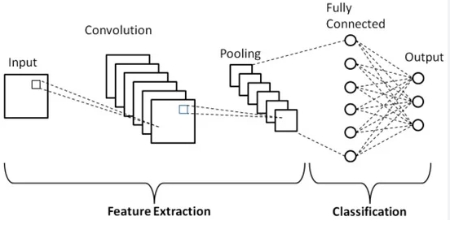
How it works -
Convolutional Neural Networks (CNNs)
Convolutional neural networks (CNNs) use convolutional layers to apply filters (kernels) that scan the input data to detect features like edges, textures, and patterns. Each filter generates a feature map that highlights the presence of specific features in the input.
CNNs also include pooling layers to downsample these feature maps, reducing spatial dimensions while retaining important information. Fully connected layers at the end of the network combine these features to make predictions.
Notes:
Convolutional Neural Networks are the generally accepted best performing deep learning architecture for image processing. As such, they (or architectures extremely similar) are used for patch processing in digital pathology

Slide 6
Squares as a patch shape
The CNN likes the square as an input image shape for a variety of reasons, including: ^{[2]}
Streamlined Convolutional Operations
Efficient Parameter Sharing
Simplified Pooling Operations
Compatibility with Pre-Trained Models
Regularization Techniques
Aligning with Standard Image Sizes
Notes:
“1. Streamlined Convolutional Operations
Many CNN architectures leverage convolutional operations, applying filters or kernels to local regions of an input image. Square input dimensions simplify these operations by ensuring that the filters can efficiently traverse the entire image without complications associated with uneven dimensions.”
“2. Efficient Parameter Sharing
CNNs benefit from parameter sharing, where the same filter weights are applied across different regions of the input. Square images provide a consistent grid structure, facilitating parameter sharing and ensuring that learned features generalize well.”
“3. Simplified Pooling Operations
Pooling layers, such as max pooling or average pooling, are used in CNNs to downsample feature maps and reduce spatial dimensions. Square images make pooling operations straightforward and uniform, simplifying the reduction process.”
“4. Compatibility with Pre-Trained Models
Many pre-trained CNN architectures and models are designed to handle square input shapes. Using square images ensures compatibility with these architectures, making it easier to leverage pre-trained models.”
“5. Regularization Techniques
Data augmentation involves applying random transformations to input images during training. Square images simplify the implementation of these techniques, ensuring consistent transformations.”

Slide 7
Uniform Patch Shapes Cont
Square patches are typically used because uniform patch shapes helps computational efficiency and consistent feature extraction: ^{[6]}
Aligns with grid structure of images
Uniformity ensures that all patches contribute equally to the classification task
Important to avoid distortion or bias introduced by irregular shapes
Article uses example of laparoscopic surgeries
Uses square patching
Achieved 98.4% in tissue classification.
Notes:
Multispectral imaging for superior tissue differentiation compared to RGB imaging
article discusses a method for intraoperative tissue classification using multispectral image patches for computer-assisted laparoscopic surgeries

Slide 8
Rectangular Patches
Study found that used rectangular patches in fundus images for detecting diabetic retinopathy ^{[7]}
Rectangular patches have been used instead of square patches before
Texture, color models, and stats measures extracted from 48x64 pixel rectangular patches
High sensitivity and specificity for detecting hard exudates
Challenges in distinguishing hemorrhages due to minor color differences
In this study, it was more practical to use rectangular patches as it fit the image structure better
Notes:
Diabetic retinopathy (DR) is a chronic eye condition that occurs when diabetes damages the blood vessels in the retina
Features such as texture, color models, and statistical measures are extracted from 48×64 pixel rectangular patches to classify normal, hemorrhage, and hard exudate regions.

Slide 9
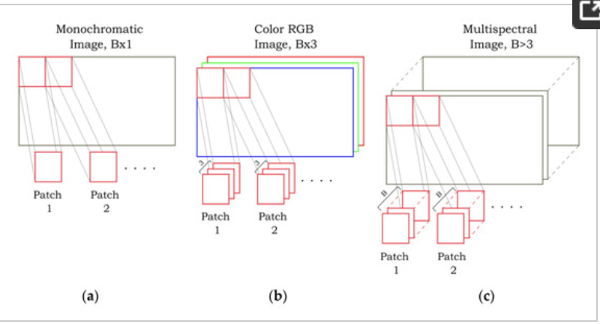
patchIT
patchIT is a tool for creating image patches tailored for different image processing tasks ^{[8]}
Customizable patch size, shape, and overlap to meet needs
Streamlines patch creation and effective feature extraction while being computationally efficient.
requires two parameters: the input image and the patch size
Used for object detection and medical imaging
We could use this for our problem to test if other patch sizes may be optimal for our data
Notes:
They provide an alternative representation of the image as a set of partial local sub-images (patches) which is a vital preprocessing step in many image processing applications. In this paper, a new software tool called patchIT is presented, providing an integrated framework suitable for the systematic and automatized extraction of patches from images based on user-defined geometrical and spatial criteria
patchIT is a versatile tool designed for extracting image patches tailored to different image processing and analysis tasks. It allows users to customize the size, shape, and overlap of patches to suit various applications like object recognition and texture analysis. The tool integrates preprocessing features to normalize input images and optimize patch extraction. By creating patches systematically, it ensures efficient data preparation and compatibility with machine learning models, enhancing performance in applications such as medical imaging, object detection, and feature extraction.

Slide 10
02
Why Powers of 2?

Slide 11
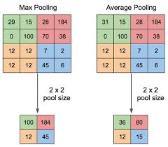
CNNs - Resizing with Powers of 2
Squares and Power of 2
The fixed input sizes of squares work cohesively with certain input dimensions of CNN layer weight matrices, which are (preferably) fixed.
However, not all images are the same dimensions, and cropping may break the spatial coherence of an image
Network Design, Downsampling, and Pooling Operations
To avoid a mismatch size exception, downsampling data can allow all inputs to have the same dimension ^{[3]}
Without powers of 2, the pooling operation may not cover the entire image depending on stride and padding.
Hardware Design
https://medium.com/aiguys/pooling-layers-in-neural-nets-and-their-variants-f6129fc4628b

Slide 12
Consequences of not using a Power of 2
Hardware Efficiency
GPU memory pages use power-of-2 organization for optimal memory alignment and access ^{[5]}
One person indicated a 30% performance drop compared to a power-of-2 of the next size up
Modern GPUs are better at handling non-power-of-2 cases
Internal Re-sizing
If image is not at a power-of-2, may initially convert it to a power-of-2 dimension
Waste of memory and processing time
Could introduce “rounding errors” where pixels don’t map evenly across dimensions
Model Design Complexity
Non-standard dimensions can lead to incompatible layer operations
To accommodate non-power-of-2 images, extra padding may be required

Slide 13
Empirical Findings - “Effect of patch size and network architecture on a convolutional neural network approach for automatic segmentation of OCT retinal layers”^{[4]}
The study explores the impact of varying patch sizes and CNN architectures on the segmentation of retinal layers based on cross-sectional patches of the ocular tissue from OCT images.
The article acknowledges that certain CNN architectures were “originally designed and tested to classify small 32x32 color images.” Yet, they make no mention of the specific benefits of using patch sizes in powers of 2, but rather seem to be referring to the relatively small patch size.
However, the dimensions were adapted to 33x33 and 65x65 to ensure that a central pixel in the patch could align with the focal area of interest, allowing the model to capture sufficient surrounding context while keeping computational costs manageable. The model with the adjusted patch size seemed to perform just as well or better in all architectures that were tested.
In conclusion, the study found that larger patch sizes generally resulted in better ability to identify retinal layers because they captured more of the surrounding tissue. For larger patches like 65x65, network architecture adjustments were necessary to handle the increased input size effectively, but smaller changes in patch size did not have a significant impact. This experiment may suggest that the notion of patch sizes in powers of 2 is effectively irrelevant.

Slide 14

Powers of 2: Addendum
224x224 in Existing Architectures
AlexNet, one of the Earliest ImageNet CNNs, down-sampled to 256 and cropped to 224 x 224 for translation invariance due to data augmentation ^{[10]}
Translation Invariance: x(t) = x(t+a)
ImageNet is a popular annual contest, and many successors to AlexNet were built on its 224x224 preprocessing size^{[11]}
Batch Sizes - Demonstrating Hardware Efficiency
Nvidia’s Tensor Cores do better with batch sizes in multiples of 8 in NN^{[12]}
Matrix multiplication (which Tensor Cores are great at) work better in dimensions of 16 bytes.
Dimensions can’t be controlled, but batch size can
While batch size and image size have little to do with each other, it’s a demonstration of the nuances of multiples in hardware efficiency.
256
256 to 224
Notes:
the representation of an object remains consistent regardless of its location

Slide 15
03
How to Optimize # of Patches?

Slide 16
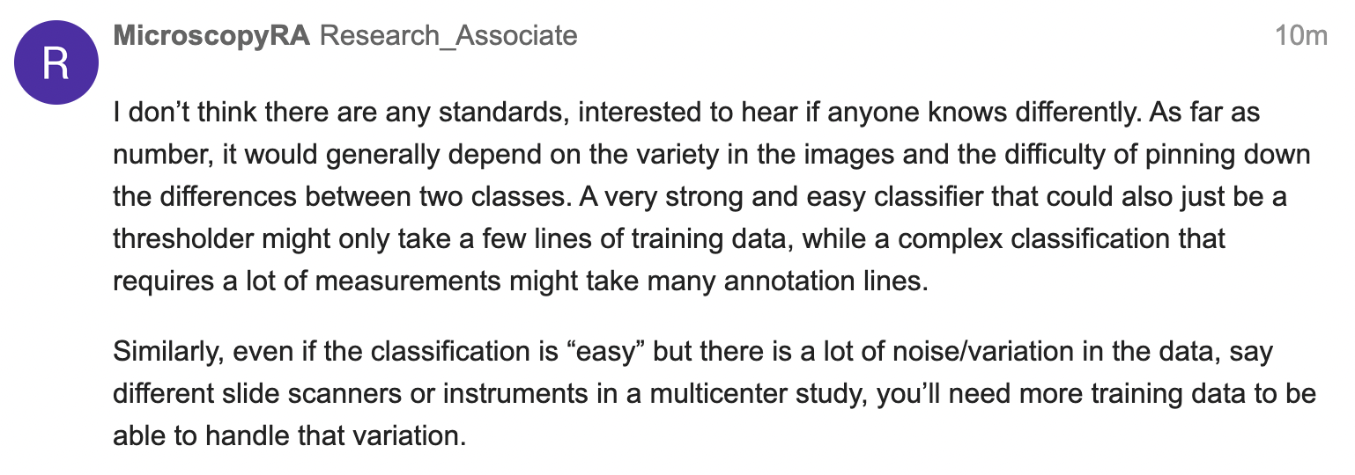
QuPath Community Forum Responses

Slide 17
Works Cited
[1]
https://pmc.ncbi.nlm.nih.gov/articles/PMC6882930/
[2] https://medium.com/@supreethmv/why-square-images-dominate-deep-learning-and-cnns-9a9bf7bf1c92#:~:text=Square%20images%20provide%20a%20consistent,that%20learned%20features%20generalize%20well.&text=Here%2C%20the%20filter%20shape%20remains,sharing%20across%20the%20square%20image.
[3]
https://keras.io/api/layers/pooling_layers/max_pooling2d/
[4]
https://pmc.ncbi.nlm.nih.gov/articles/PMC6033561/
[5]
https://pmc.ncbi.nlm.nih.gov/articles/PMC4977982/#abstract1
[6]
https://pmc.ncbi.nlm.nih.gov/articles/PMC5265243/
[7]
https://ieeexplore.ieee.org/document/7848208
[8]
https://www.mdpi.com/2414-4088/6/12/111

Slide 18
Works Cited Cont
[9]
https://bmcbioinformatics.biomedcentral.com/articles/10.1186/s12859-018-2111-8
[10]
https://www.cs.toronto.edu/~fritz/absps/imagenet.pdf
[11]
https://arxiv.org/pdf/1409.1556
[12]
https://docs.nvidia.com/deeplearning/performance/dl-performance-matrix-multiplication/index.html#gpu-imple
[13]
https://medium.com/aiguys/pooling-layers-in-neural-nets-and-their-variants-f6129fc4628b

